Slide 1
WHITE BOX TESTING

Slide 2
INTRODUCTION
White box testing techniques analyze the internal structures the used data structures, internal design, code structure and the working of the software rather than just the functionality as in black box testing. It is also called glass box testing or clear box testing or structural testing.

Slide 3
It is the testing of each and every line of code in the program.
Developers with his teams(tester) do White Box Testing, sends the software to testing team. The testing team does black box testing and checks the software against requirements and finds any defects and sends it to the developer.

Slide 4
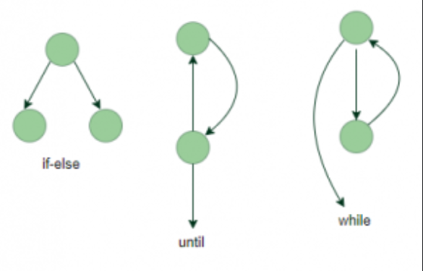
Flow Graph
It is directed graph consisting of nodes and edges It is drawn with the sequence of the code.
Nodes represent sequence of statements or decision points.
flow graphs means representing the flow of the program, how each program is interlinked with one another.

Slide 5
Flow graph
1
2
1. Start
2. Buy / Rent
3. Buy
4.Rent
5. Select the product and Number of days
6. Shipment
7. Payment
8. End
3
4
5
6
7
8

Slide 6
Cyclomatic Complexity
Cyclomatic complexity is a software metric used to measure/indicate the complexity of software/program.
This metric provides a complexity measure based on the number of linearly independent paths through a module

Slide 7
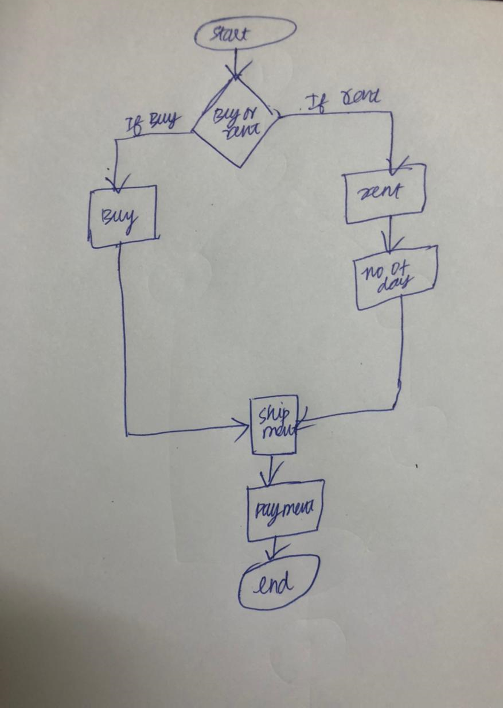
Cyclomatic complexity :
E - N + 2p
where E = number of edges=8
N= number of nodes=8
p = number of connected components (usually 1)
So, for this control flow :
8edges – 8 nodes + 2(1) = 2

Slide 8
Unit / Component Testing
Unit / Component Testing: In procedural programming, Unit may be, an individual program or a function or a procedure, etc.In object oriented programming, the smallest unit is a class. Unit may be called as a Component . Validates the source code of a defined functional unit.
Helps a Software Developer to : Test code for correctness .Design better (i.e., more cohesive ,less coupled code) Re-factor code faster .Enhance documentation. Provide means for performance regression testing. Is a proactive approach to code. Unit Test should cover ,Code , Branches, Paths ,Cycles

Slide 9
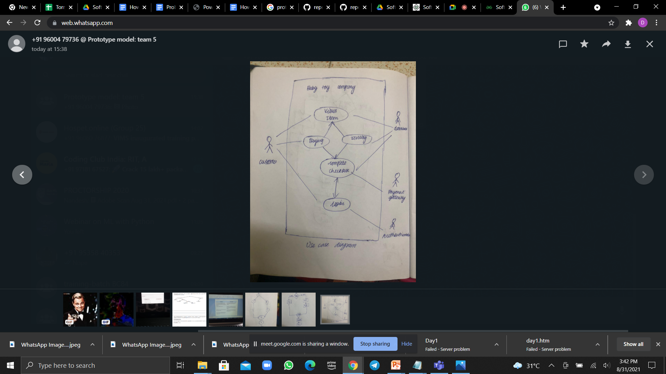
Use case diagram

Slide 10
Regression Testing
The Regression test is when all the test conditions are re-executed for function modules influenced by a change or bug fix to the program.
It is very important to ensure that the change or bug fix does not introduce any unwanted impact to the current system.
During this test, the test data is the same as before so that it can be compared to the pre-defined expected test result.
When there is a change during the software development life cycle, regression testing is needed.
This test also happens during the Unit Test phase

Slide 11
Performance Testing
The Performance test checks the performance capability of software or a system.
Software cannot be considered ‘good’ when its performance is poor, even if it fulfills the required functionality. Therefore, it is necessary to conduct performance tests.
To build a high performance software system, the performance should be considered at earlier phase. e.g., technical design phase. and the performance of every program unit is the basis of the whole software system.
A formal Performance Test should be conducted after the Assembly Test.
However, it is also sometimes necessary to check the performance during the Unit Test phase.

Slide 12
GUI Testing
Graphic User Interface Testing (GUI) testing is the process of ensuring proper functionality of the graphical user interface (GUI) for a specific application. This involves making sure it behaves in accordance with its requirements and works as expected across the range of supported platforms and devices.

Slide 13
